Slide 1
Birdham Parish Council Open Morning
19th March 2016

Slide 2
Grants
New Homes Bonus
Approximately £15000 for Adult Fitness equipment held by CDC awaiting a acceptable plan.
But we are told you want new play equipment
As an aside the equipment at East Wittering which we were asked for cost £70,000
S106 monies
£25000 available to drain the Football Pitch,
But estimated cost is £40-60,000

Slide 3
Annual Budget
Monies From Precept
~£40,000

Slide 4
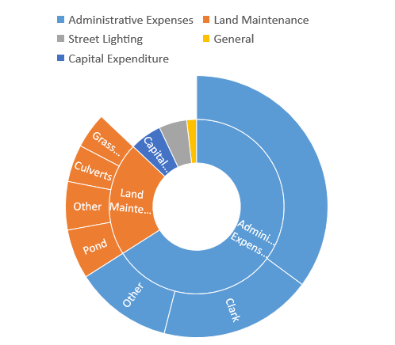
Planned Expenditure
This is what cripples us
£17182/yr.
on
Mortgage for the Village Hall
Monies From Precept
~£40,000

Slide 5
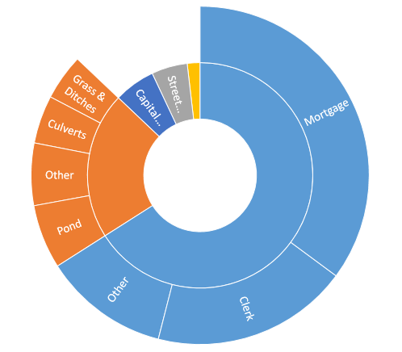
Money Available to upgrade Playing Field.
Monies From Precept
~£40,000
Grants available to drain Playing Field
£25000
Estimated Cost
£40- 60 thousand
Monies Available to upgrade Playing Field
£750 From Precept
£750 From Precept

Slide 6
Birdham, we have a Problem!
Currently we have no capability to upgrade the playing Field.
Very limited resources even to perform essential maintenance of existing assets and equipment
Some Blue Sky thinking was required

Slide 7
One Possible Solution
Develop part of the Playing Field
Whilst maintaining the original playing area
How?

Slide 8
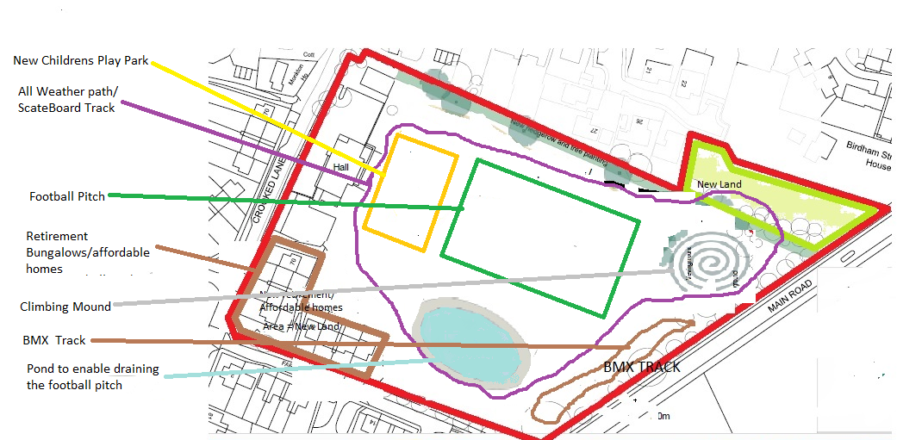
Potential Projects for the Playing Fields
X

Slide 9
Is there a Business Case
Detail | Amount | Comments
Cost to build 9 homes | ~£900,000 | Assuming £140/sq. ft.
Revenue from selling 5 Starter Homes | ~£1,500,000 | Based on starter homes in Chichester
Potential Funds available to the Parish | ~£600,000
Outstanding Mortgage | £181,000
Improvements to Playing Field | ~£330,000
Other Projects | ~£50,000
Total | £561,000

Slide 10
Yes there is a solution
But!!
It’s a lot of work, before so we embark on this project do we have your support ?
Is there any way you would like to see it changed?
this is your chance to influence the design.

Slide 11
So what are the benefits
Provide affordable Homes for the youngsters in the village.
Build much needed social/retirement homes.
Secure the future of the Village Hall.
Make the Playing Field somewhere where people want to go, not avoid.
Provide small annual income to supplement our precept.
Maybe a little extra for other projects.

